Slide 1
You Are What You Tweet
What do your tweets say about you?

Slide 2
You Are What You Tweet is a game that tests your ability to recognize your friends’ online voices. The object is match the author to the tweet. The more matches, the stronger the online personality.

Slide 3
The Online Voice
The Online Voice is distinct and recognizable web based persona.
Our app gives the user a raw score rating how recognizable or unique their online voice is.
This would be helpful for corporate brands, comedians, writers, politicians, or anyone who’s curious.
This would also allow companies a way to measure how effective their marketing efforts are.

Slide 4
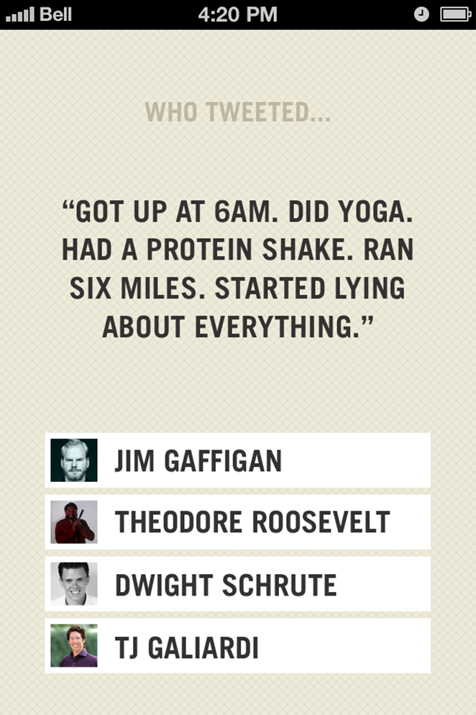
Phase 1: Minimum Viable Product $30,000

Slide 5
Phase 1: Minimum Viable Product $30,000
Phase 1 releases a basic version of the app. It covers the design, the programing and server space for the software.
Our CTO, App Raptors LLC, is a team that has agreed to develop this app for $40/hr as opposed to their going rate of $150/hr.
The app is downloadable for free to encourage usership.
Featured tweets will garner revenue.

Slide 6
Featured Tweets ($$$)
Occasionally a tweet from a sponsor will be a question. This interactive advertising encourages the user to internalize the ad and to associate the company with its funny or cool tweet.
This is a valuable marketing strategy that could be very profitable for both the featured sponsor and us as well.

Slide 7
Example:
Hate yellow sports cars? Get back at the owners by hailing every single one you see like it's a taxi. #KCS
@TacoBell
@Klondike
@JackBox
@Snapple

Slide 8
Phase 2: Online Voice $20,000
Phase 2 introduces The Online Voice. You Are What You Tweet gathers the data that determines your ability to stand out online. Here we give the user a raw score.
Also available is the option to watch an ad for additional points.
A celebrity version is playable for points in this stage as well.

Slide 9
Phase 3: Analytics
In Phase 3 players are given the option to pay a monthly fee for access to their in game statistics.
How often their friends correctly guess their name as the author of an anonymous tweet.
How often their tweets show up as a question.
How often their name shows up as a possible answer to the anonymous tweet.
Who the users were mistaken for.
What other users sound similar to them online.
How many total questions they answered.

Slide 10
This page will have the results from this poll
How entertaining does this game seem? (1 to 5)
How much fun do you think it would be to guess friends’ posts? (1 to 5)
How much fun do you think it would be to guess celebrity posts? (1 to 5)
How much time do you think you would spend playing this app? ( 1 or 2 hours a day, 1 or 2 hour a week, 1 or 2 hours a month or less)
Every 20 or so tweet would be from a sponsored. Would that bother you?
How likely would it be for you to tell your friends about this? (1 to 5)
How much, maximum, would you be willing to pay for this app? ($0, $1, $2, $4)

Slide 11
Projections
X % of surveyed would pay $y for the app. * # of iPhone users = market cap
Make a goal to capture %10 of the market/total iPhone users within a certain period of time
Typically, advertisers pay $_ per impression of a featured ad. Since our featured ads are much more interactive than typical ads, we think we can charge $_.

Slide 12
This page is for the request
We would like to find 1 to 5 investors to cover the cost of development ($30,000 to $100,000)
Based on our projections, we believe $1,000 per percent ownership is a good starting valuation.
Other needs:
Marketing Officer
Marketing expenses
Sales team (to sell Featured Tweet space)

Slide 13
Points
Points are scored through several ways:
Correctly guessing the author.
Having another player guess you as the author to your tweet.
Inviting another twitter account to play.
Clicking on an in-app advertisement.
The more points one has the more they are featured in the game.

